Slide 1

Machine Learning Business Proposal
Data Science 2 - MBAN
Group 8
Ao Li – 218020289
Nara Tan – 220089264
Qian Wang – 219346956
Saima Rafi – 216562753
Rahul Baid – 220089991
Chengjie Lou – 217648502

Slide 2













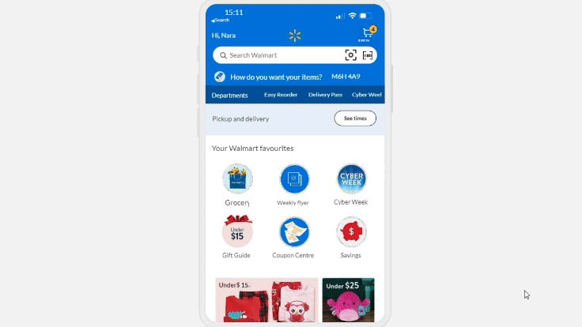
Overview & Opportunity Identification
Retail business since 1962, & in Canada since 1994 & hold significant market share. It’s a Global retail giant known for low prices and quality
Current Status
E-commerce platforms: Walmart App, Walmart.com and Jet.com
Provide services to their customers via various channels
Opportunity
Integrating AI technologies to enable 'Visual Shopping'
Reduce search time and enhance engagement
Lead to higher conversion rates and more potential sales
Machine Learning
Enable accurate product discovery by understanding visual cues for diverse customer queries
Ensure accurate tagging and categorization for a vast array of products
Adaptable to increasing range of products and inventory
Can seamlessly integrate with the existing platform infrastructure ensuring a smooth user experience
Allows for collecting more valuable data on user preferences, search patterns, & popular products, enabling data-driven business decisions
Scalable and can handle the growing demands of an expanding e-commerce.

Slide 3
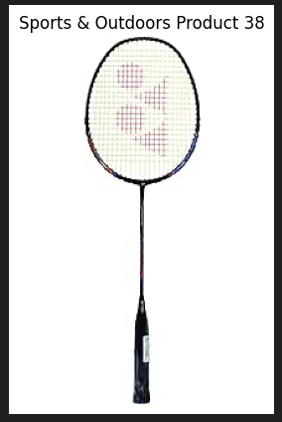

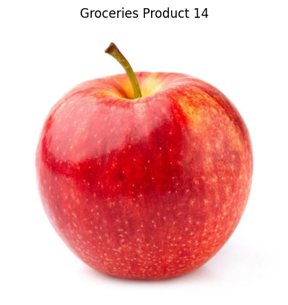
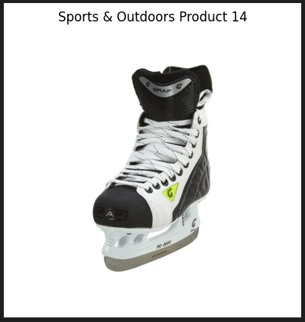
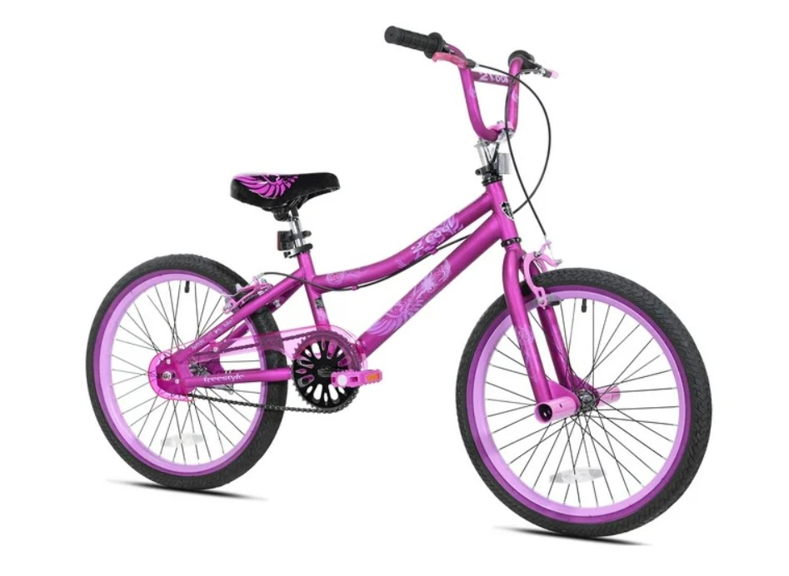
Data Requirement & Collection
Types of Data
01
02
03
Walmart Inventory Images
Real Time Inventory data
User-Generated Images
Walmart Inventory Images
Real Time Inventory data
In the absence of a Walmart API connection, random data has been generated for model training.
The products are primarily categorized into four main groups ‘Groceries Product’, ‘Sports & Outdoors Product’ , ‘Beauty & Health Product’ and ‘Electronics Product’
Below are sample images from the dataset.
This dynamic dataset shows the prices, status, and other relevant data
Below are the sample related random dataset is created associated with images.
Category | Product Name | Price | Stock Status | Rating
Sports & Outdoors | Sports & Outdoors Product 38 | $128.88 | Out of stock | 1.46
Beauty & Health | Beauty & Health Product 73 | $42.89 | In stock | 1.59
Groceries | Groceries Product 14 | $184.78 | Out of stock | 3.21
Electronics | Electronics Product 92 | $155.64 | In stock | 3.69
User Generated images
This dataset is used as dummy for the purpose of prototype

Slide 4
Data Collection Plan
01
02
03
04
05
Define Objectives
Identify Data Sources
Data Integration & image labeling
User generated data
Barcode &Textual Data Mapping
Objectives is enabling the camera feature in Walmart app for Walmart inventory searching within all products.
Leverage existing data sources within the Walmart including product databases & Barcode database
Integrate image data seamlessly with the existing dataset - maintain a unified inventory structure with image labeling.
Implement mechanisms to securely collect and store user-generated images along with relevant metadata
Establish a mapping mechanism to connect barcode and textual data with corresponding images.
06
07
08
09
10
Data Security & Ethics
Quality Control
Data Preprocessing & Documentation
User Feedback Mechanism
Data Storage
Communicate data usage policies to users and obtain consent & prepare Ethical data & model Consideration plan
Monitor and filter out irrelevant or inappropriate images to maintain data quality.
Prepare data Storage plan and ensure storage solution is scalable to accommodate a growing dataset
Apply preprocessing steps to standardize and clean the collected images before model training & document the entire data collection process.
Ensure user feedback mechanism is in place for Continuous improvement

Slide 5




Data Preprocessing and Issues
Data Cleaning
Labeling & Annotation
Image Resizing -Resolution Variances
Handling Color Spaces
Data Augmentation
Product Info. Gaps Imputation techniques, filling missing values
Labeling product for accurate classification.
Annotation must be Consistent & Precise
Resize images to a predefined resolution to maintain uniformity
Preserve the aspect ratio of the images to avoid distortion.
Convert images to a consistent color space (e.g., RGB, HSV)
The choice of color space affects how image data is stored and manipulated
Random rotations, flips, zooms, or other transformations like shear to improve model generalization
Normalization/ Scaling
Handling different Product Categories
Handling Imbalanced Data
Abnormal user Behavior
pixel values range 0 - 255, where 0 (black) and 255 (white).
Standardizing / normalize pixel values to the [0, 1] range enhances model convergence & stability
User-Generated Images Prompt users for upload error if user-generated images are unrelated objects.
Train a new classification layer on top of the pre-trained model.
Extract features from the pre-trained model's layers to focus on category-specific features.
Underrepresented product managed by oversampling, undersampling.
Additional preprocess consideration may include but not limited to Computational Resources, Quality Assurance, Data Splitting

Slide 6

































Data Storage Plan & Ethical Consideration
Data Types
Storage Architecture
Security Measures
Scalability
Retention Policies
Compliance & Auditing
Leverage existing database
Product Images
Barcode & textual database
Create storage system for
User-Generated Images
Leverage exiting electronic distribution network and rely on;
Centralized Database
Enable Backup mechanism
Adopt data security measures:
Access Controls
Encryption
Data Masking
Storage facility to handle growing business needs:
Cloud-Based Solutions
Load Balancing (optimal performance)
Define Retention policies for user-generated images
Regular review & monitoring for
Regulatory Compliance with laws like PIPED*, CPPA** & Digital Privacy Act
Storage Plan
*Personal Information Protection& Electronic Documentation
**CPPA – Consumer Privacy Protection Act
User Privacy
Data Security
Data Ownership
Regulatory Compliance
Algorithmic Accountability
Communicate the measures taken to secure and protect user-generated images
Encrypt all information sent to and received from customer devices
Establish guidelines for the data ownership, erasure and retention of data
Comply with all applicable laws, as applicable
Establish a procedure for verifying and elucidating the model's results.
Ethical Consideration – Data & Modeling
Transparency & Fairness
Informed Consent
Sustainability
Feedback & Redress
Clearly explain the implications of using the camera to capture images
Consider effects that using machine learning models - Energy Consumption, Increased Electronic Waste
Establish a procedure for responding to user grievances and fixing problems
Be transparent about the decision-making and prediction processes

Slide 7
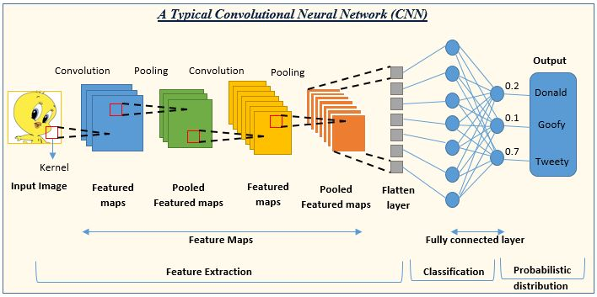





Model Selection
Business Objectives
VGG16
Image searching for products
Rank the output products properly
Handle a large variety of images
Scalable
Maintainable
Fast
Inception
RestNet
AlexNet
Designed for Image Related Tasks
Inspired by the connectivity of neurons in the brain
Progressively captures features from low to high levels crucial to understand product structures in images
Utilizes convolutional filters for systematic image scanning to capture product details
Scalability and Variety
Adaptable architecture can accommodate large and diverse datasets
Fast and Resource Efficient
Utilize small and local receptive fields to capture local patterns efficiently
Share weights across spatial locations reducing memory usage and computational requirements
Reduce spatial dimensions with pooling layers to enhance efficiency
Efficiently compute local interactions between pixels using convolutional operations
Can leverage pre-trained models for efficient feature extraction on new tasks
Can use specialized layers (batch normalization, dropout) for faster convergence and better generalization
Mature for Business Application
Proven to be highly effective in tasks such as image recognition, object detection, medical image analysis etc
Deployed in facial recognition, product recognition, and quality control in diverse

Slide 8
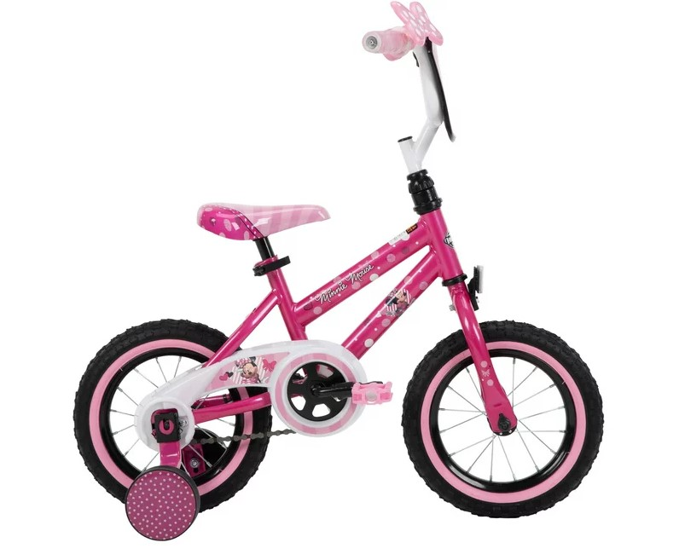

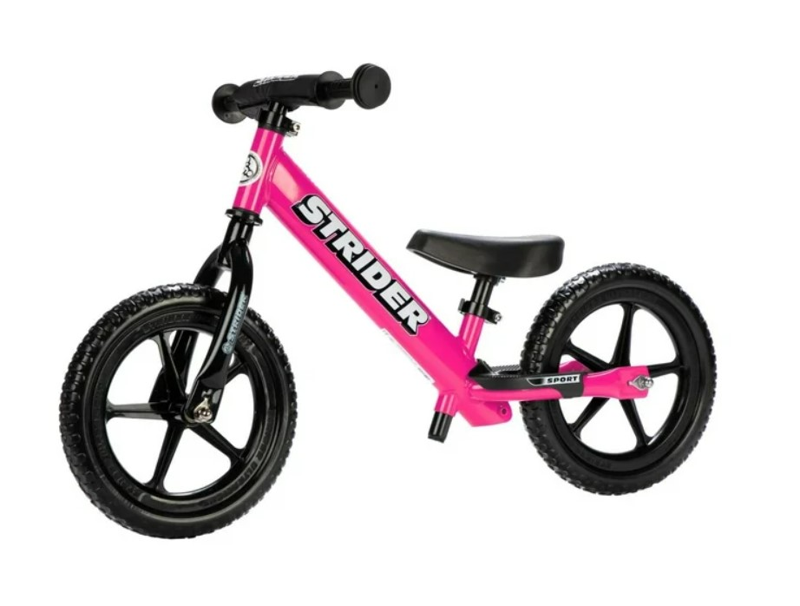



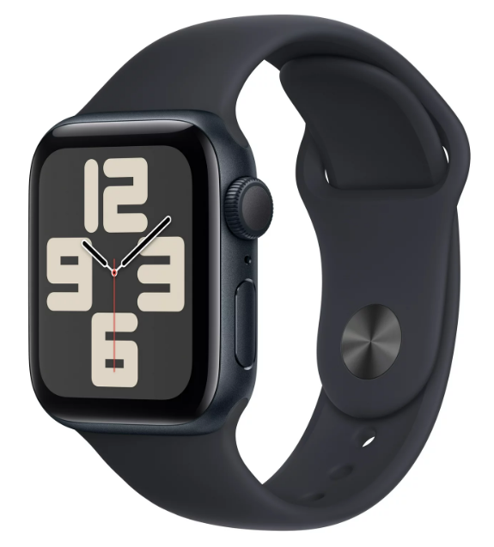











Model Validation and Evaluation-Classification
Train ResNet for Walmart images
Sports & Outdoors
01
02
03
04
05
Use metrics 'Accuracy’ & ' MSE' to evaluate the model's performance on image classification & image similarity comparison
Evaluate and assess trained model generalization on the test dataset (unseen data)
Label the inventory images by the categories
Split the data sets into training, test and validation
Validate the trained model on the validation dataset to assess its performance

Slide 9
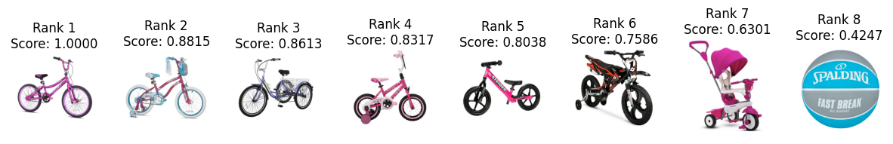
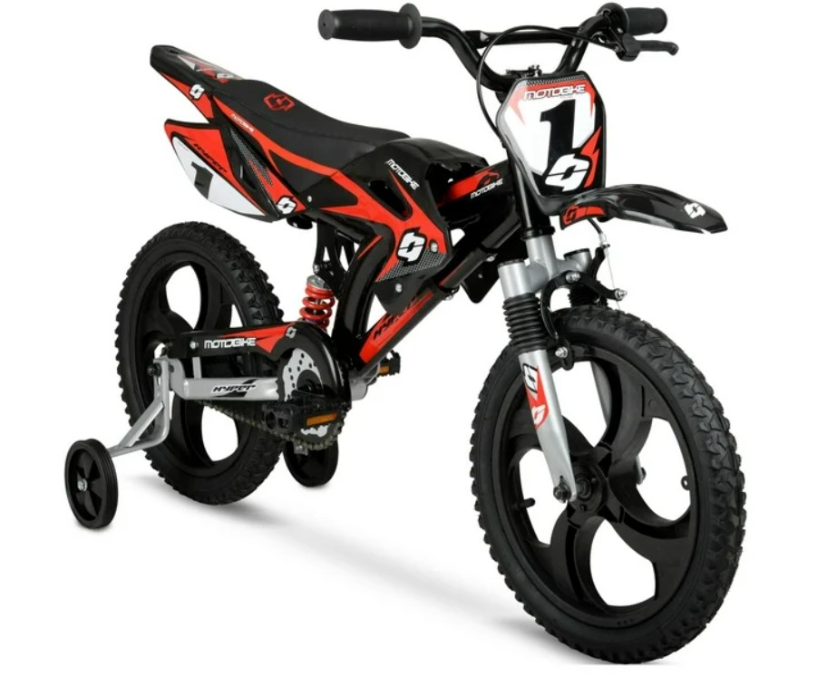
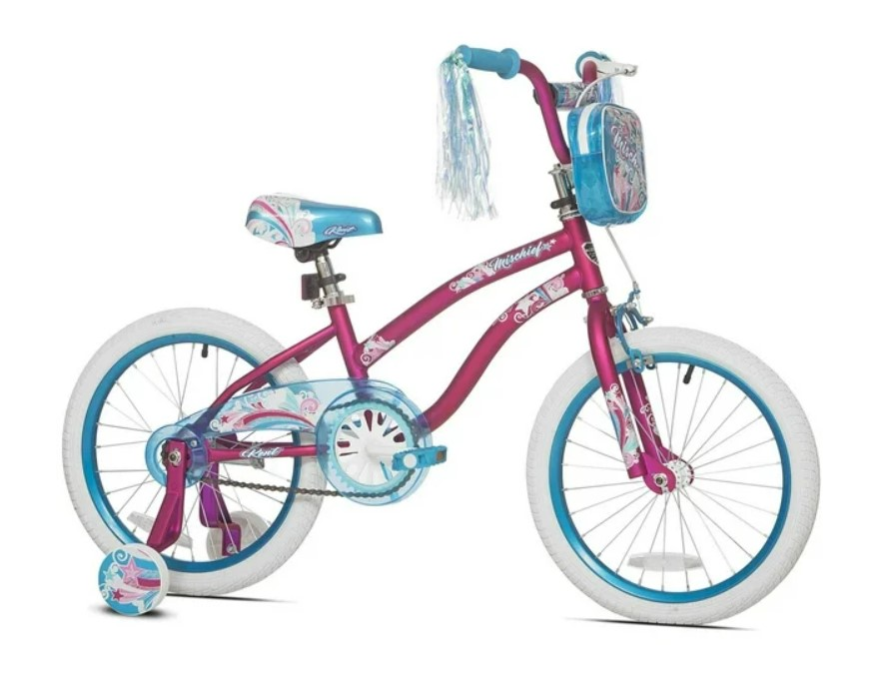
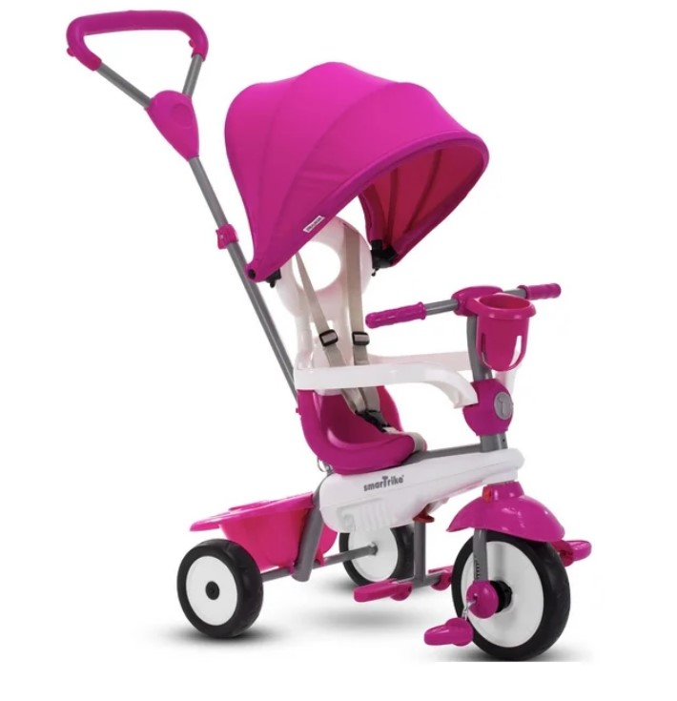
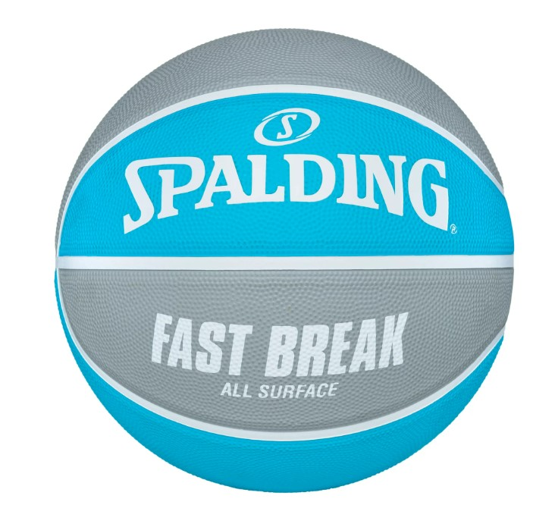
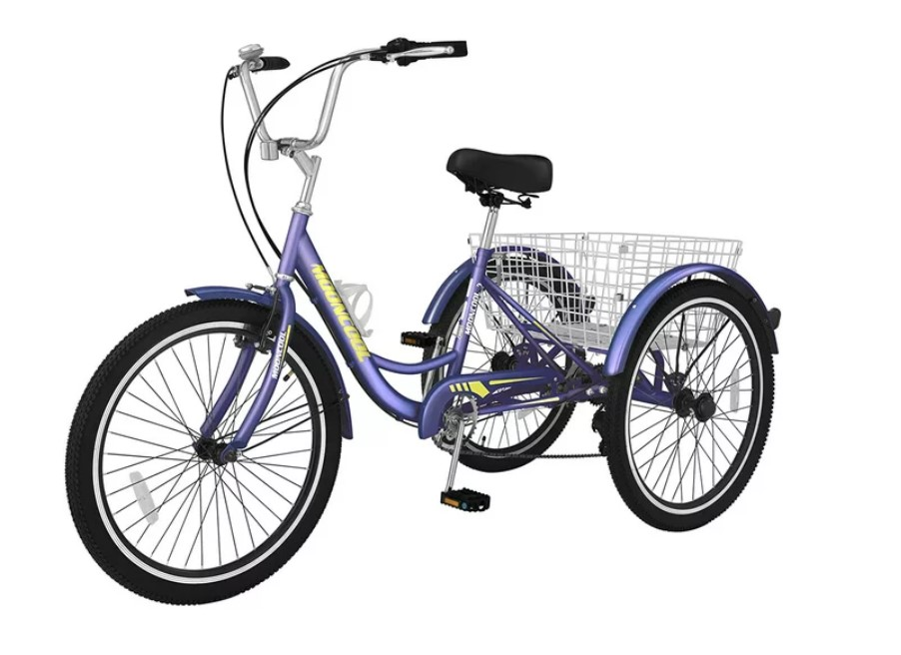
Model Validation and Evaluation-Similarity Comparison
Assign Ground Truth Similarity Scores to each pair of images
Predicted the similarity score of uploaded image against others inventory images
Calculate MSE as a performance matric
MSE measures the gap between True Score and Predicted Score
Truth Score 1
Predicted Score 0.99999994
Truth Score 0.65​
Predicted Score 0.7586​
Truth Score 0.8
Predicted Score 0.8317
Truth Score 0.6
Predicted Score 0.8038
Truth Score 0.75
Predicted Score 0.8815
Truth Score 0.5
Predicted Score 0.6301
Truth Score 0.45
Predicted Score 0.8613
Truth Score 0.0001
Predicted Score 0.4247

Slide 10





Technical Implementation
Feature Extraction & Indexing
Search Query Processing
Integration with the E-commerce Platform
User Interface and Experience
Testing and Optimization
Privacy & Security Considerations
Using ResNet for feature extraction, creating detailed feature vectors, supported by efficient and streamlined data indexing systems, enhancing the accuracy and speed of image search capabilities.
Enhanced to manage a broad range of image sizes and qualities, particularly from mobile uploads, ensuring quick and accurate image processing.
Aiming for a scalable API architecture with an advanced product relationship mapping to elevate the shopping experience.
Developing an intuitive, user-friendly search interface, optimized for both mobile and web platforms, to enhance personalized user interaction.
Focused on precision testing, regular A/B testing, and continual improvement through learning systems and user feedback.
Ensuring robust data protection and compliance with international standards to safeguard user privacy and security.

Slide 11

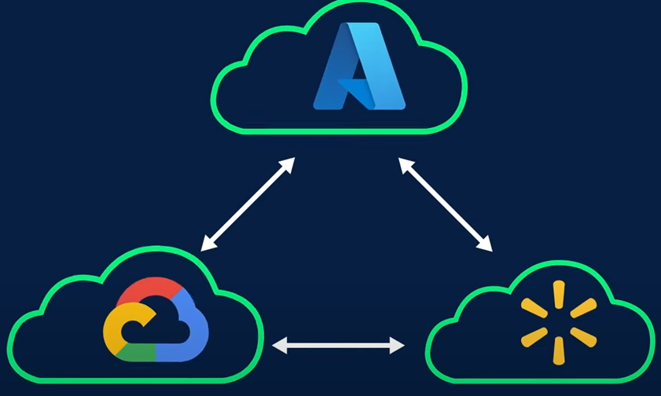









Business Case, Projected Cost & Estimated ROI
RESOURCE COST
MODEL DEVELOPMENT
Monthly Cost ~ $100,000
Business Analyst
Coding Team
Data Analyst
Monthly Cost ~ $70,000
Expenses related to developing and fine-tuning the ML model.
LEGAL
INTEGRATION, TESTING & QA
T&C may require additional coverage of the implications of using the camera to capture images.
No additional Cost due to In-house Legal team.
Allocating resources for integrating, testing & QA for the new feature.
No additional Cost due to In-house team.
Walmart own world's biggest hybrid clouds on an architecture, designed to run a workload on Azure, Google Cloud or the Walmart Cloud Native Platform -- a Kubernetes-based system
CLOUD SERVICES
MAINTENANCE & UPDATES
Leverage existing cloud services.
Limited costs will be associated with APU usage and Data Storage
Server expenses, API Integrations.
Regular updates for optimal performance
Projected Cost (CAPEX and OPEX)
$ 1.36M
Project Duration: 8 Months appx.
ROI
(333%)
* Reference: https://www.altamira.ai/blog/image-recognition-cost/
Profitability
$ 162M
Notes:
1. Cost Factors:
Development team size and expertise.
In-house vs. outsourced team.
Third-party services (data scientists, software developers, designers).
2. Average Project Cost:
Business analytics: $2,000 to $12,000 monthly.
Coding: $2,000 to $70,000 monthly.
3. Cost of Data Analyst:
Minimum $1200 monthly.
Ongoing Maintenance:
1. Monthly Costs:
Vary based on features and usage.
Server expenses, API integrations, extra features, marketing, and maintenance costs.
2. Long-term Considerations:
Ensure continuous updates for optimal performance.
Regularly assess and adapt to evolving market trends.
Based on that the total project cost can range from $10,000 to $500,000, depending on the size of the implementation.
Since Walmart has a team for each of these, there won't be any added cost for the below services for the new feature: LEGAL, TESTING, MAINTENANCE

Slide 12
Risk & Mitigation
Model Risk
Market Adoption
Data Security
& Privacy
Integration
Challenges
HIGH
LOW
HIGH
MODERATE
LIKELIHOOD
HIGH
LOW
MEDIUM
MEDIUM
IMPACT
HIGH
MEDIUM
HIGH
MEDIUM
INHERENT RISK
Inaccurate results due to outdated model with old data
Acceptance
Legal issues arise due to data privacy breaches
Integration to Production environment
Mitigation
Regularly monitor & validate the model for accuracy
Robust marketing strategies
Strict data security protocols, compliance with regulations
Thorough system analysis

Slide 13
Conclusion & Recommendation
Based on the analysis and development of prototype following are the conclusion & recommendation:
Boosting Customer Retention and Growth:
Introducing a visual shopping feature aligns with current trends in e-commerce and can contribute to customer retention and growth and enrich the customer shopping process.
Revolutionizing E-Commerce:
Harness the Power of machine learning for accurate and personalized product searching and recommendations.
Positive Impact on Profitability:
Utilizing existing data resources for the enhancement of the app ’s ‘Visual shopping’ feature can lead to a positive impact on Walmart's profitability with proactive managing risk.

Slide 14

Thank you

Slide 15
Annexure
Assumptions:
Current Average # of Customers 37Mn
25% assuming will use the new feature in 1st year
Daily image upload by per user is 15
Project Duration 8 Months – Project development & resource cost
Average # of Customers | 37,000,000
Assuming 25% uploads | 9,250,000
Project Duration | Per Month | 8 Months
Resource Cost * | $ 100,000 | $ 800,000
Development cost * | $ 70,000 | $ 560,000
Total Capital Expenditure (CAPEX) |  | $ 1,360,000
Storage Cost 12 months (OPEX) ^ | $ 3,019,016 | $ 36,228,192
Total Investment |  | $ 37,588,192
Daily Image per user | 15
Daily Storage Requirement = Average Image Size×Number of Daily Uploads (GB) | 270,996.09
Max Image Size in GB (to be resized to max 2 MB) | 0.001953125
# of Pics Uploaded Monthly(GB) | 8,129,883
Flat Monthly GB allowed | 2040
Rate for monthly per flat rate | $ 757.55
Monthly Cost | $ 3,019,016.04
Approach 1
Approach 2
Assumptions:
Increase in current profitability by 1% due to new feature i.e., ~ $162Mn
Assumptions:
25% of users will generate $1 for 1 year (per day revenue increase
~ $ 2Mn
ROI = 333% after netting off CAPEX & OPEX
ROI = 2146% after netting off CAPEX & OPEX
* https://www.altamira.ai/blog/image-recognition-cost/
^ https://azure.microsoft.com/en-ca/pricing/details/cloud-services/

